Slide 1
CPABC Accessibility Initiative

Slide 2
CPABC Accessibility Task Force Mandate
Discuss Accessibility best practices and understand their impact on CPABC’s Activities and Initiatives (even those outside of legislated requirements)
Understand the scope of government legislation and timing for implementation of different stages of accessibility
Understanding the scope of learning required for different team members and developing a learning plan for the organization
EAC will help guide this process, however, all departments are responsible for understanding their own accessibility requirements

Slide 3

People with Disabilities
22% of the Canadian population
(over 15 years of age) have a disability or functional limitation that creates accessibility barriers.
Statistics Canada (2017)
In BC the number varies from 17 - 20%.

Slide 4
What is a Disability?
A disability is any condition of the body or mind that makes it more difficult for the person with the condition to do certain activities and interact with the world around them.
Our responsibility will be to ensure that anyone that comes to the CPABC website(s), is able to access information – no matter what their abilities are.

Slide 5

Kinds of Disabilities
Disabilities include:
  visual (blind, color blind, partial blind or poor eye-sight)
  auditory (deafness or hearing impaired)
  motor/mobility (tremors, muscle slowness, Parkinson’s, muscular dystrophy, cerebral palsy, stroke, missing limbs, chronic pain, etc.)
  cognitive disabilities (dyslexia, learning difficulties, etc.)

Slide 6

What is Accessibility?
Accessibility - the extent to which as many people as possible can effectively use a product, device, service, or environment.

Slide 7

What is Web Accessibility?
Web Accessibility - the inclusive practice of ensuring that there are no barriers preventing people with disabilities from interacting with or accessing websites on the World Wide Web.

Slide 8

Goals for CPABC (2021 – 2024)
To educate CPABC staff about web accessibility and what it means for us as an organization.
To ensure that by 2024, CPABC Websites are Accessible and we have removed as many
accessibility barriers as we can.

Slide 9

CPABC Accessibility Task Force
Accessibility needs to be understood by all of us.
It needs to be:
        Championed (All of us)
        planned
        implemented
        monitored
        reported on
        And maintained
Accessibility needs to be a CPABC organizational initiative.

Slide 10
Scope for Web Accessibility
In order for CPABC to become web accessible, all our “web content” must comply with WCAG. (Web Content Accessibility Guidelines)
“Web content” refers to:
  Web Text (HTML)
  Images
  PDF’s
  Videos
WCAG sets the standards and best practices for accessibility.
WCAG are the basis of most accessibility laws around the world.

Slide 11
What is WCAG?
The 4 W’s of Web Production
.
WWW - The World Wide Web -
1.83 billion websites, stored on web servers & connected to local computers throughout the internet. (1993-94 mainstream)
2. W3C - The World Wide Web Consortium (W3C) is an international community that develops web standards and best practices. (1994)
3. WAI – Web Accessibility Initiative (WAI pronounced "why") is an initiative of W3C. WAI creates standards and guidelines that supports web accessibility. (1997)
4. WCAG – Web Content Accessibility Guidelines was developed by WAI. WCAG is a list of guidelines that must be followed in order to be web accessible. (WCAG 2.1 – 2018)

Slide 12

WCAG – Creating an Inclusive Web
.
Sir Tim Berners-Lee
Inventor of the WWW in 1989
Director of W3C (World Wide Web Consortium) - started in 1994
Professor of Engineering at MIT

Slide 13
Accessibility at CPA
CPABC will follow the WCAG 2.1 AA
Ontario - CPA Canada and CPA Ontario are both WCAG 2.0 AA compliant (as of January 2021) – now law under the AODA (Accessibility for Ontarian Disability Act)
  In Ontario - Private or non-profit organizations with more than 50 employees and all public sector organizations had to make their website and web content compliant with (WCAG) 2.0 Level AA by January 1, 2021. (Exception: other than criteria 1.2 4 (live captions) and 1.2.5 (pre-recorded audio descriptions)
The Accessible BC Act has recently passed in
BC (June 17, 2021) – still waiting for regulations and standards.
WCAG 2.1 contains all of the same principles and guidelines as WCAG 2.0. The main change – 17 new success criteria added to 2.1.

Slide 14
Other Forces are Behind Accessibility?
United Nations Convention on the Rights of Persons with Disabilities states:
  Access to information and communications technologies, including the Web, is defined as a basic human right in the United Nations Convention on the Rights of Persons with Disabilities (UN CRPD).
Canada’s Standard on Web Accessibility - which took effect August 1, 2011, mandates Government of Canada websites and web applications to meet WCAG 2.0 AA criteria.
Accessible British Columbia Act has now received Royal Assent. (June 17, 2021) With the Act now law, government will establish accessibility standards and regulations.
British Columbia’s Accessibility 2024 Goal – “making B.C. the most progressive province in Canada for people with disabilities by 2024”. (2014)
Ontario has now become WCAG 2.0 AA compliant as of January 1, 2021 (AODA). Web Accessibility is now law in Ontario. (This includes CPA Canada and CPA Ontario.)
Pressure from people and organizations that focus on people with disabilities
Depending on what country, state, province you are in, companies/organizations can now be sued & fined for not following accessibility guidelines.
CPABC is a self-regulating body, an educational organization, and we strive to be inclusive – these three points are a strong forces to why we need to be accessible.

Slide 15
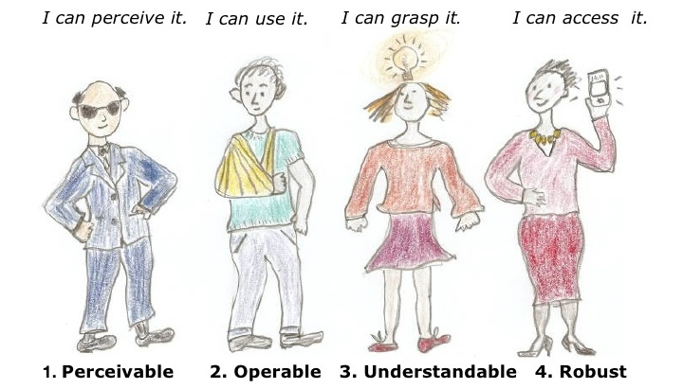
How to Become WCAG Accessible
WCAG is built on four governing principles, commonly referred to by the acronym POUR.
Perceivable;
Operable;
Understandable
Robust.

Slide 16
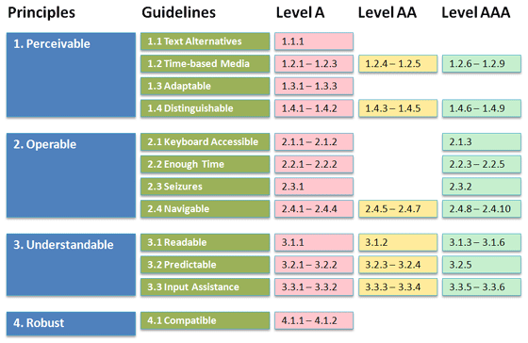
WCAG 2.1 – Guidelines and Criteria
Under the four governing principles, there are 13 guidelines and 78 success criteria
Each guideline and criteria item is assigned a level (A, AA, AAA)

Slide 17
WCAG Guidelines (A, AA, AAA)
Each guideline/criteria is assigned a level or ranking. Levels become progressively harder to achieve.
  A - easiest to achieve, basic accessibility conformance.
  AA - medium difficulty to achieve, international best practice requirement.
  AAA most complex, only for specialized sites that have specific features.
To comply with WCAG 2.1 - AA, CPABC must fulfill all A and AA guidelines. (Level A is a subset of level AA, we must meet all A and AA criteria items in order to achieve AA compliance.)
CPABC must comply with 50 success criteria items. (instead of 78 if we had to comply with level AAA)
CPABC does not need to comply with any AAA guidelines or criteria (specialized sites only).

Slide 18
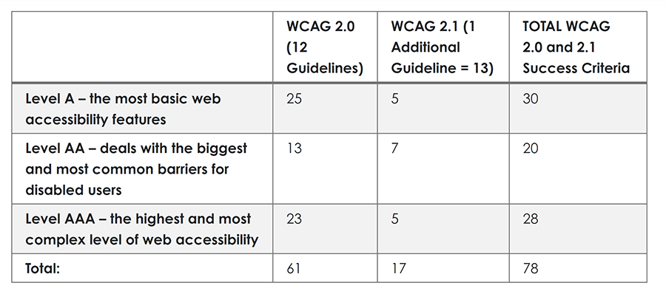
WCAG Guidelines (A, AA, AAA)

Slide 19
WCAG Guidelines - Reality
Important: A website cannot be 100% accessible.
The reality is that accessibility is a continuum. If a site fails all WCAG criteria, it will still be accessible to some people, and even if it passes all of the criteria, some people may not be able to use it because their needs fall outside of the narrow scope of the guidelines.
The WCAG Guidelines encompass Visual, Auditory, Mobility & Dexterity, and Cognitive disabilities. A simplified guide is located on the Accessibility Web Resource.

Slide 20
Accessible PDFs
PDFs are included in the scope of web accessibility requirements.
CPABC has hundreds of PDFs on our websites and there are hundreds of links directed to our PDFs. These PDFs will need to be made accessible.
An accessible PDF can be read and accessed by people with disabilities, primarily people who are vision-impaired that may use assistive technology to read the file through a screen reader or a Braille printout.
For a PDF to be accessible the master source of the PDF must also be accessible.
Staff will need to be trained on creating accessible PDFs.

Slide 21
Videos
Videos are included in the scope of web accessibility requirements.
Captions, described video, transcripts, and descriptions must be included where appropriate.
All future video production, needs to take Accessibility into account.

Slide 22
Images
Images are included in the scope of web accessibility requirements.
Images must be tagged appropriately and designed appropriately

Slide 23
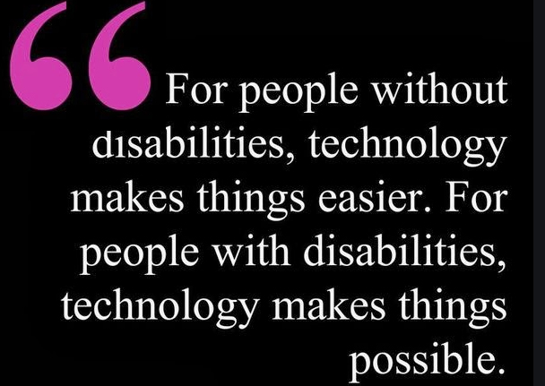

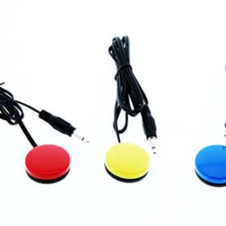
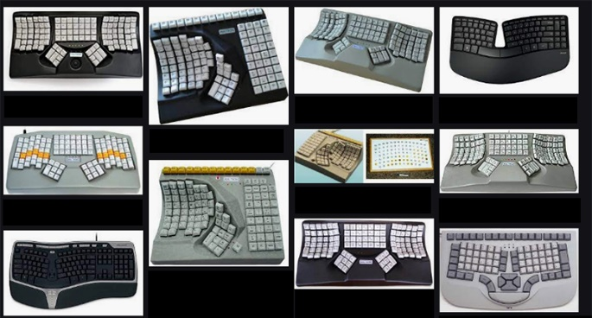
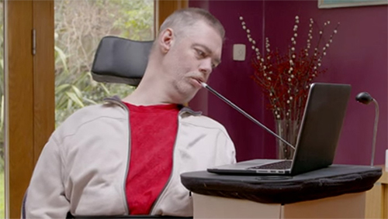
Assistive Technologies
Assistive technologies (AT) are specialized hardware or software products that help people with disabilities.

Slide 24
Assistive Technologies
Screen Readers
A screen reader is a form of assistive technology that works with the programmatic html/aria attributes behind the web page and renders the information as speech or braille output. (text to speech or text to braille)
Screen readers are essential to people who are blind, and are useful to people who are visually impaired, or have a learning disability.

Slide 25
Assistive Technologies
Popular Screen Readers
Google Screen Reader
Microsoft Narrator
Mac OS X Voiceover
JAWS
Note: Operating systems on computers, tablets, and mobile devices offer a wide range of built-in customization features to help meet vision, mobility, language, and learning needs.

Slide 26
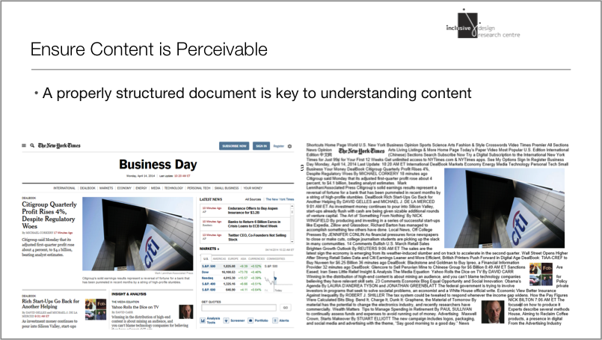
Assistive Technologies

Slide 27
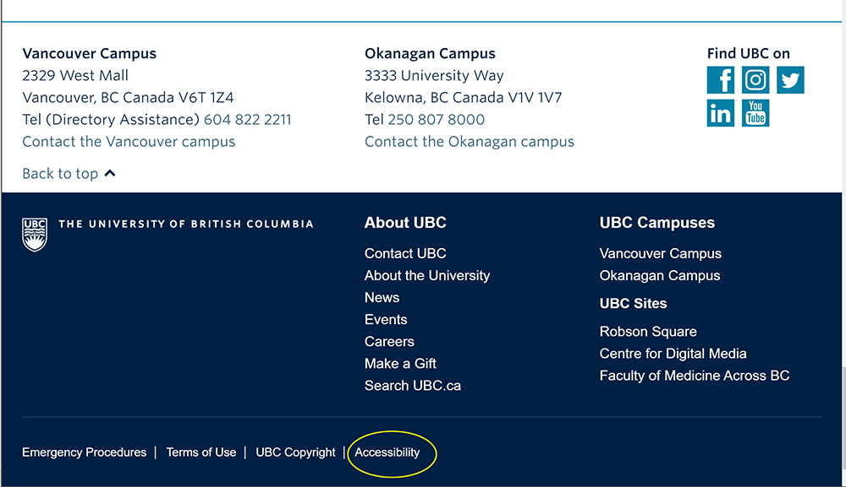
Accessible Websites
UBC
University of British Columbia is committed to making its websites usable by people of all abilities or with age-related limitations.
A new version of the UBC CLF (Common Look and Feel) Web Template has been designed to be web accessible – meets WCGA 2.0.

Slide 28
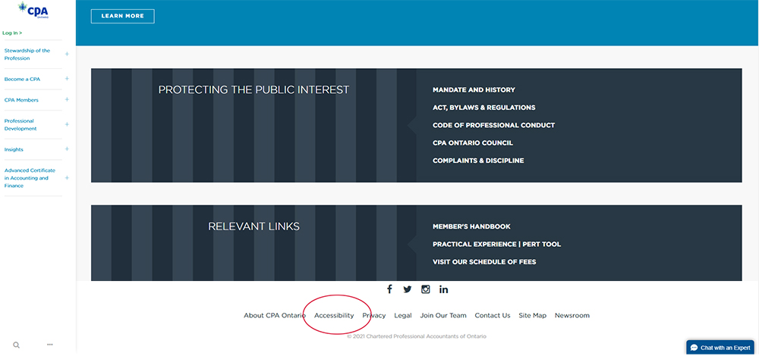
Accessible Websites
CPA Ontario
By law, in Ontario, websites must be accessible if they are:
a private or non-profit organization with 50+ employees; or
a public sector organization
Beginning January 1, 2021: all websites must meet WCAG 2.0 AA other than criteria 1.2 4 (live captions) and 1.2.5 (pre-recorded audio descriptions)
See CPA Ontario's - Accessibility plan (PDF),
statement, and standards policy document.

Slide 29
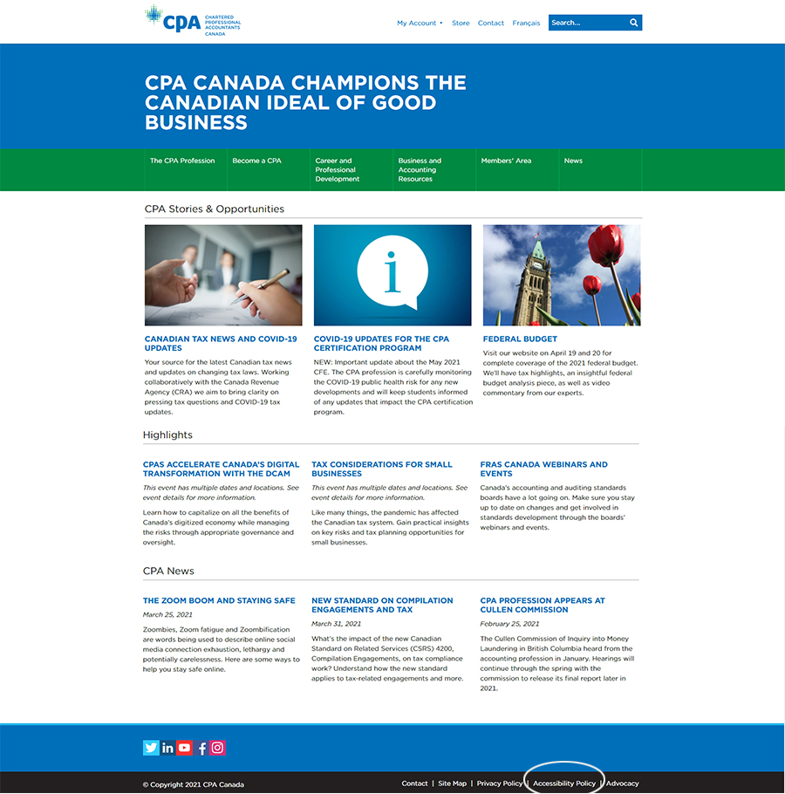
Accessible Websites
CPA Canada
By law, in Ontario, new and significantly refreshed public websites must be accessible.
Accessibility Policy
Multi-Year Accessibility Plan (PDF)
Check out CPA Canada’s site for their accessibility plan, statement and standards policy.

Slide 30
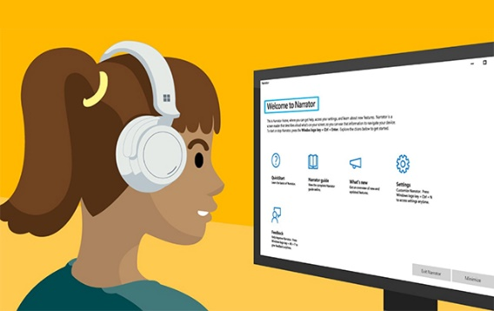

Testing for Accessibility
We recently conducted a preliminary web accessibility test on our corporate site and scored 73.6%.

Slide 31
Steps to Achieving Accessibility
Over the next few years, CPABC websites will undergo a series of code audits, code changes, updates, and revisions in order to meet both accessibility guidelines (WCAG) and future legislation.
In addition, we will develop a training plan for staff who will be focused on creating accessible content, and developing implementation strategies for other areas as needed.
Visit www.bccpa.ca/accessibility mini site for accessibility timeline
  Implementation timeline (2021 – 2024)
  Other CPA Provinces:
    Reached out to 5 (AB, SK, MB, ON, NS)
    Create a national accessibility task force and share information across CPA

